Slide 1
How easily to create a POP song?
Speaker: Johnny

Slide 2
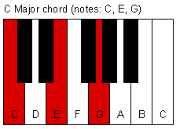
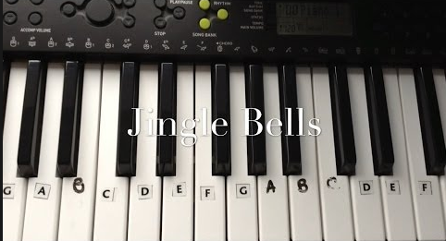
Easy POP Chorus
Basis of chorus
Chorus on piano
Usually F –> G –> Em -> Am in whole song !

Slide 3
What’s In Your Mood?
Fill the lyrics in the melodies !
POP music always talks about something unmeaningful.
Now watch me whip (Kill it!)
Now watch me nae nae (Okay!)
Now watch me whip whip
Watch me nae nae (Want me do it?)

Slide 4

Put Your Instruments Down!
Using a music arrangement application.
Put down the instrument you like.

Slide 5
Q & A

Slide 6
Thanks for listenening!

